Slide 1
MEDICAL INSURANCE PREMIUM PREDICTION

Slide 2
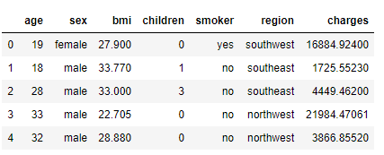
OBJECTIVE:
The objective of the project is to study the various factors which has the greatest effect in predicting Medical expenses using various Regression Techniques and to formulate models depicting the effects of these factors. We will try to evaluate all the possible combination of variables.
DATA DESCRIPTION:
https://www.kaggle.com/mirichoi0218/insurance
The dataset had 1338 data points and 7 variables

Slide 3
Dependent variable (Y):
Medical insurance premium; Individual medical costs billed by health insurance.
Independent variables (X):
Following factors affect the premium of medical insurance:
Body mass index: BMI is an indicator of the fitness level of insurance bearer. Disproportionate BMI is a sign of an unhealthy body likely to get affected by diseases.
Age: The age group given in data is 18-64. With increasing age people are more prone to different ailments which should get reflected in the premium costs as well.
Sex: This binary attribute provide details about the gender of the primary beneficiary
Smoker: This is also a binary attribute which can have effect on the health of the insurance bearer.
Region: The beneficiary's residential area in the US, northeast, southeast, southwest, northwest. Health of people is affected by the demographic factors and the socio economic development of that area.
Children: Number of children covered by health insurance / Number of dependents.

Slide 4
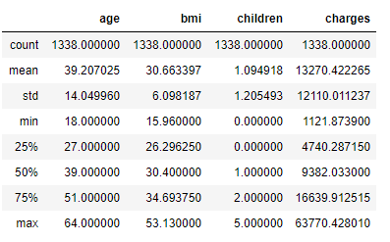
METHODOLOGY:
Data Preprocessing
Descriptive Statistics
Data visualization
Construct Correlation Matrix
Identify Significant Independent variables
Check for OLS assumptions
Construct Multiple Linear regressions
DESCRIPTIVE STATISTICS:

Slide 5
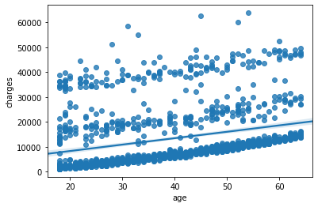
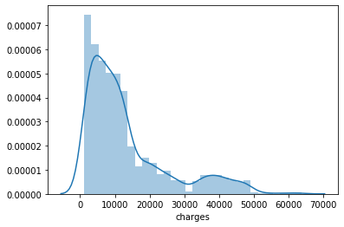
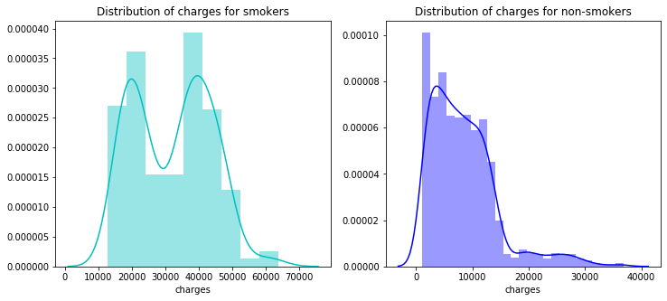
DATA VISUALIZATION (CONTINUOUS VARIABLES):

Slide 6
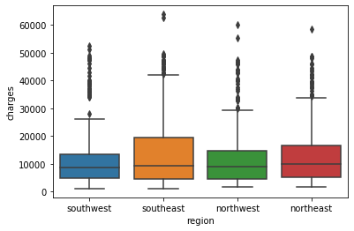
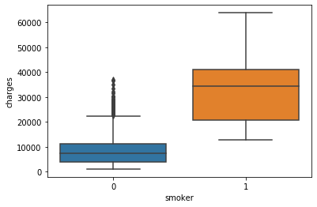
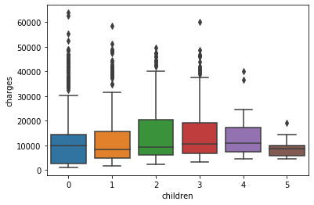
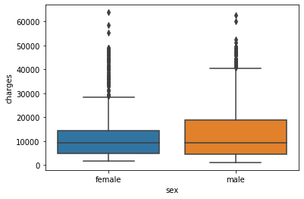
DATA VISUALIZATION (CATEGORICAL VARIABLES):

Slide 7
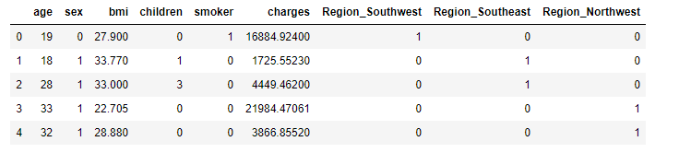
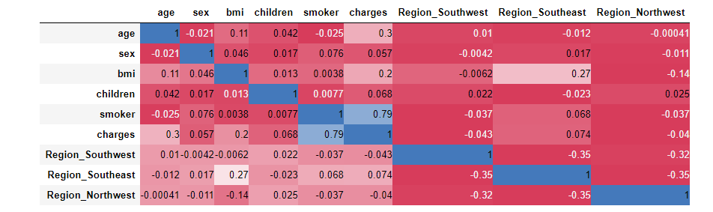
DUMMY VARIABLE TRAP:
CORRELATION MATRIX:

Slide 8
MULTI-COLLINEARITY
No perfect multi-collinearity exists
Dummy variable trap is taken care
No two independent variables exhibit Imperfect multi-collinearity more than a threshold of 0.3
HETEROSKEDASTICITY
In order to verify heteroscadasticity assumption, white test was performed to test the null hypothesis against the alternate hypothesis the data is Heteroscadastic
The P-Value obtained was not significant enough to reject the null hypothesis
So we could safely apply ordinary least squares to our data
We performed the white test for the heterokedasticity test
H0 : Data is Homoskedastic (P > 0.01)
H1: Data is Heteroskedastic (P < 0.01)
INDEPENDENT PARAMETERS | H0 | H1 | P VALUE
Age | Homoskedastic | Heteroskedastic | 0.13
BMI | Homoskedastic | Heteroskedastic | 0
Smoker | Homoskedastic | Heteroskedastic | 0.27

Slide 9
REGRESSION SUMMARY:
 | MODEL 4 | MODEL 5 | MODEL 6 | MODEL 7 | MODEL 8
Intercept | -6424.8 | -3459.09 | -2391.62 | -1.168e+04 | - 6590.15
Age | 241.9 |  | 274.8 | 259.5475 | 264.18
BMI | 332.9 | 388.0152 |  | 322.6157 | 145.37
Smoker |  | 2.359e+04 | 2.386e+04 | 2.382e+ 04
Smoker*BMI |  |  |  |  | 802.29
Adjusted R - squared | 0.116 | 0.657 | 0.721 | 0.747 | 0.818

Slide 10
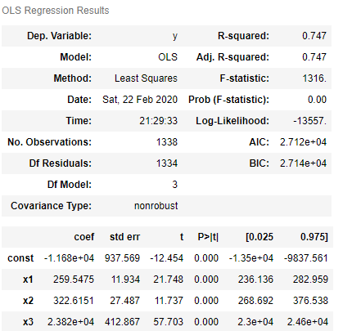
MULTIPLE LINEAR REGRESSION:
CHARGES = β0 + β1 * AGE + β2 * BMI + β3 * SMOKER

Slide 11
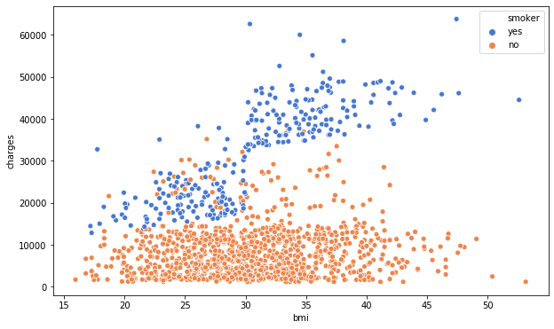
CONTD..
X1 Affects the relationship between X2 and Y
Smoker or not affects the relationship between the BMI and Charges
For every 1 unit increase in BMI charges changes by β2 + β3 SMOKER
If the individual is a smoker then β2 + β3
If the individual is not a smoker = 0 then β2

Slide 12
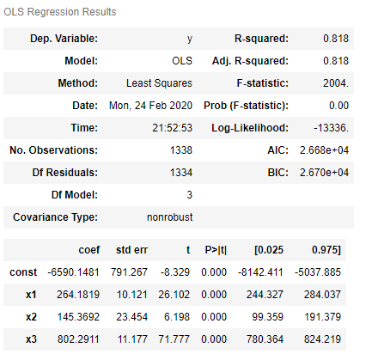
MULTIPLE LINEAR REGRESSION WITH INTERACTION VARIABLE
CHARGES = β0 + β1 * AGE + β2 * BMI + β3 ( BMI * SMOKER)

Slide 13
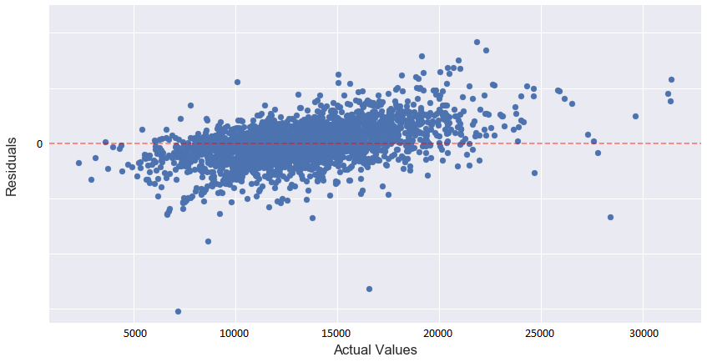
RESIDUAL PLOT:

Slide 14
OMITTED VARIABLE BIAS:
Drinking habits
Choice of profession
Genetics
Quality of treatment
Pre-Existing Medical History
CONCLUSION:
The most important variables are
Smoking habits
Body Mass index
Age
R squared value for the model is 0.818 which signifies that around 82 percent of the variance has been explained by these three variables.

